Slide 1
Real Estate Website
homyz.
aman jain
Gla University
Computer Science and engineering
29-Nov-2023

Slide 2
Introduction
Real Estate commonly reffered to as buying and selling of properties.
It consist of buying and selling properties and services over an electronic system such as the internet and other computer networks.
Our system is a real estate website from where people can buy and sell properties online so they escape from the problem of Limited Operating Hours, Limited Product Information, Costs and Overheads etc.
Admin monitors the activity of the users and checks the requests made by the user.

Slide 3
Features :-
Properties lists.
Map.
Authentication.
Add a property.

Slide 4
Problem statement
Real Estate website is important because inadequate property verification and transparency in listings hinder trust among users, requiring a solution that ensures authenticity and comprehensive property details..
Real Estate websiteis important and relevant because of limited interactive features and communication tools on current platforms restrict seamless interaction between buyers, sellers, and agents, demanding enhanced functionalities for smoother transactions

Slide 5
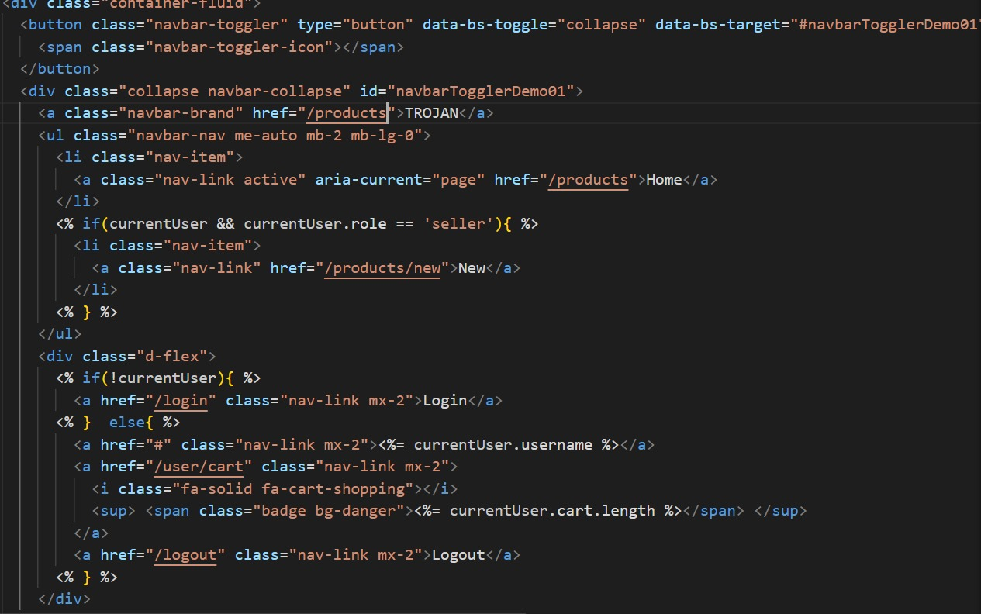
Implementation

Slide 6
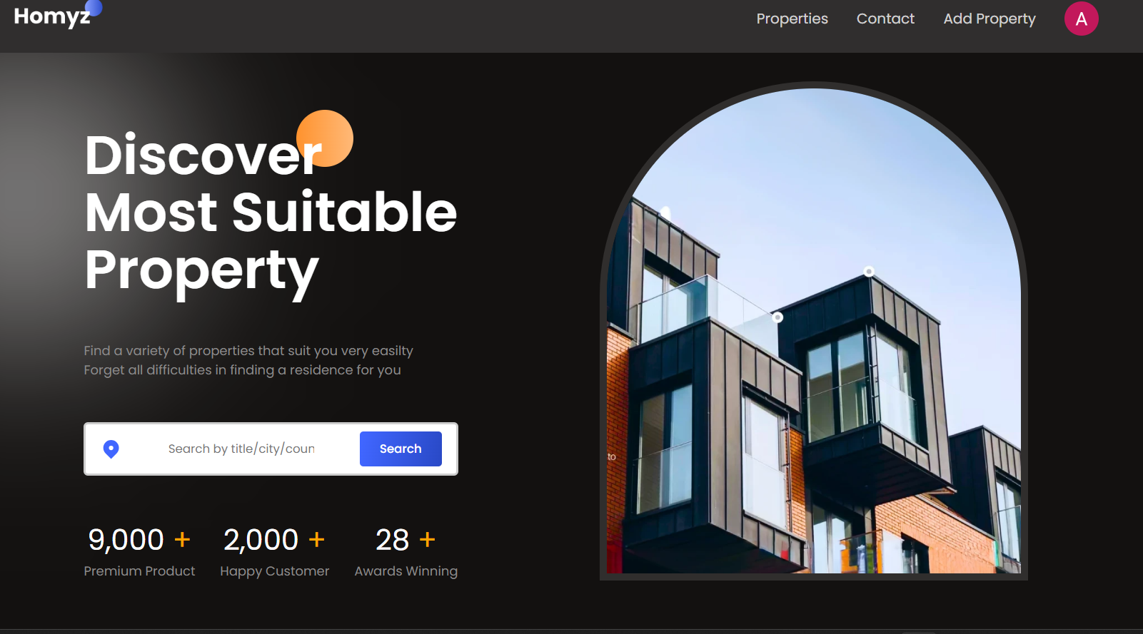
Home page

Slide 7
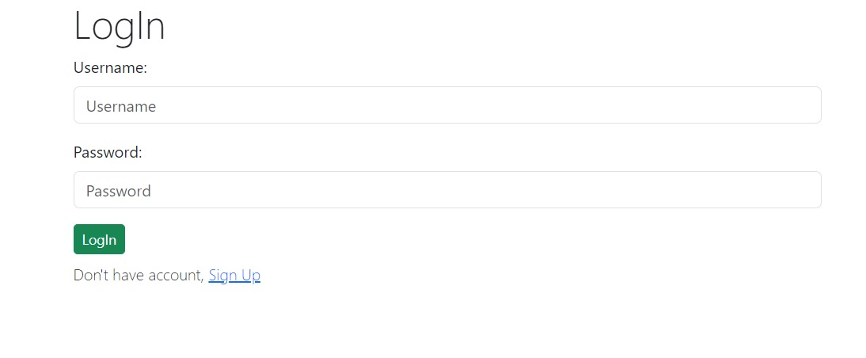
Log in page

Slide 8
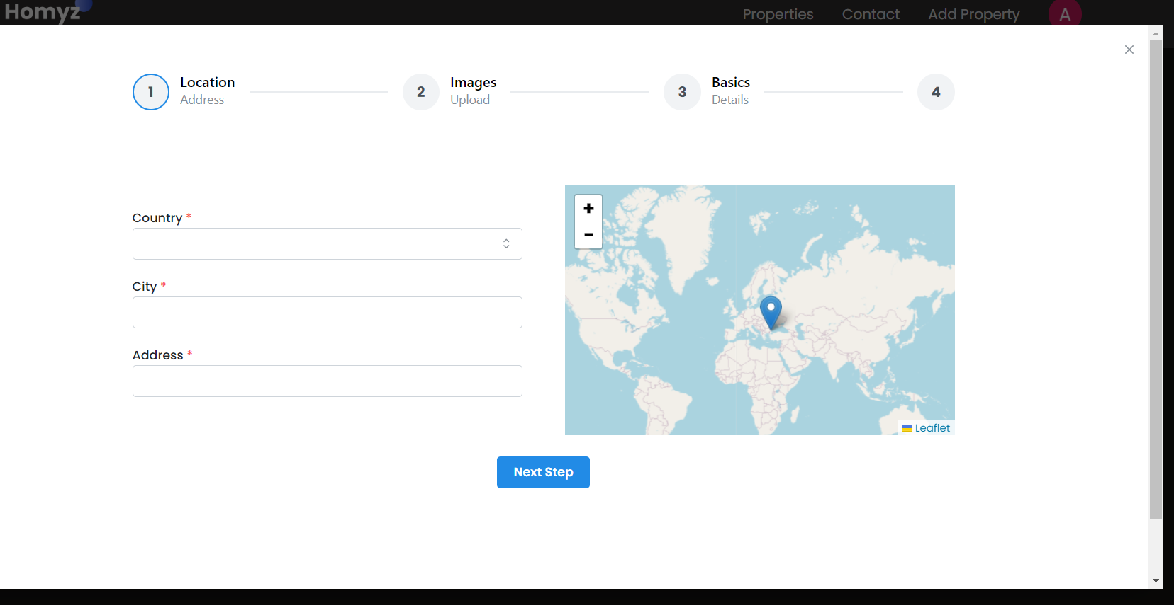
Add a Property Page

Slide 9
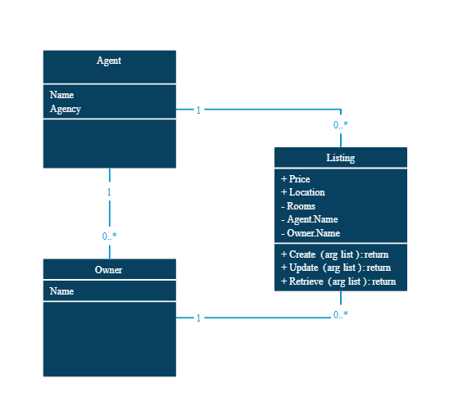
Diagram

Slide 10
Challenges faced
We faced lot of errors while working with backend.
While working on the authentication process using passport module of Npm .
we are able to solve it using articles , blogs and of course chatgpt.

Slide 11
Future work
We are thinking some modifications and adding some new features in out system. Some of them are:-
GUI modification (more user friendly)
Add Video.
Etc.

Slide 12
Conclusion
Many of the business are converted in to online system. So these businesses need website that identify them . So the owner need some extra functionality to enhance their business and can engage customer to generate more sales. So for this we need a real esate website.

Slide 13
Acknowledgements
We extend our sincere appreciation and gratitude to our mentor , Mr. Ankit Arora and to everyone who contributed to the successful development and presentation of this real estate project.

Slide 14
Thank you!

